Slide 1
Lecture 14
User-defined functions
Function: concept,
syntax, and examples
© 2010 Daniel Valentine. All rights reserved. Published by Elsevier.

Slide 2
User-defined scripts & functions
MATLAB is built around commands & functions: both sets are computer codes that accept input from the user and provide output. The latter does not use or save variables in the workspace.
Functions and M-file command scripts allow you to do technical computing efficiently; well designed code helps you to tasks multiple times.
It is necessary for you, as the programmer, to know exactly how a function performs its task; otherwise, how would you know that it is doing the task correctly.

Slide 3
Concept on function M-files
User-defined functions are similar to the MATLAB pre-defined functions.
They take a certain number of inputs, perform some operation, and give output(s).
Just as with MATLAB built-in functions, we need to know what they are supposed to do, and know that it does it correctly.

Slide 4
Syntax for functions
Calling a user-defined function:
  my_function(x)
Defining a user-defined function:
  function y = my_function(x)
  x is a value that is the input to my_function.
  my_function performs a functional operation.
  y is a value that is the output of my_function.
Functions must be written in M-files. The M-file must have the same name as the function.

Slide 5
Notes on functions
The convention for naming functions is the same as for variables. A function name must start with a letter, should be meaningful, should not use the name of an existing function, and should not be excessively long.
It is important that you give meaningful variable names to variables inside a function that you write, so that you and others can understand what the function does.
Comments become extremely important in functions. Comments help both you and anyone who might use the function to understand what it does.

Slide 6
Examples of function M-files
function volume = volume_sphere(radius)
volume = (4/3)*pi.*(radius^3);
function perimeter = perimeter_square(side)
perimeter = 4 .* side;
function root = square_root(x)
root = x.^(1/2);

Slide 7


Using a function in the Command Window
User-defined functions are accessed in the same way as any MATLAB built-in functions.
The function M-file, in this case the perimeter_square function from the previous slide, must be saved as “perimeter_square.m” in your current directory (otherwise it must be in the path)*.
You use it by typing in the command window:
*Note: The directory that your function is saved in MUST be in the path; otherwise MATLAB will not be able to find and run the file.

Slide 8
Input/output & functions
Several kinds of functions can be created with different combinations of input and/or output:
  Functions with input and output arguments
  Functions with input arguments and no output arguments
  Functions with output arguments and no input arguments
  Functions with neither input arguments nor output arguments

Slide 9
Function with multiple inputs
User-defined functions can have a number of input parameters. They can also have a number of output parameters.
Recall the constant acceleration equation of free fall:
  x = x_{o} + v_{o}t + (1/2)at²
  This equation can be coded as a user-defined MATLAB function as follows:

Slide 10


Function with multiple inputs and outputs
The acceleration of a particle and the force acting on it are as follows:
  a = (v2-v1)/(t2-t1) % An approximation!
  F = ma % Newton’s second law
  A user-defined function can be created to perform both of the calculations.

Slide 11
Hands on
Use the acceleration_calculation function to calculate the acceleration and force on an object with the following properties:
v1=4 m/s, | v2=7 m/s, | m= 2 kg,
t1= 0 s, | t2= 10 s
Since acceleration_calculation has two outputs, we must set it equal to two variables when we call it. The syntax is: [acceleration, force]=acceleration_calculation(v2, v1, t2, t1, m).
The same method must be applied to all functions with multiple outputs in order for them to work properly.

Slide 12
Functions with no input
If you need to access some constant value a number of times, instead of hard-coding the constant value every time it is needed, we can hard-code it once into a function that has no input.
When the constant is needed, its value is called via the function.
As an example, if we needed, for whatever reason, the mass of the earth (in kg) multiple times, we could write a function to store it as follows:

Slide 13
Functions with no output
Functions with no output can be used for many purposes, such as to plot figures from a set of input data or print input information to the command window (output here implies results from operations on input; no just displays).
The built-in MATLAB function tic has no output. It starts a timer going for use with another built-in MATLAB function, toc.

Slide 14
Functions with no input or output
A function with no input or output consists of some hard-coded information that is to be used in a specific procedure.
An example of this is a function that plots a specific figure. Plotting the figure is the only thing the function does; it does not have any input or operations that lead to computed values for output.

Slide 15
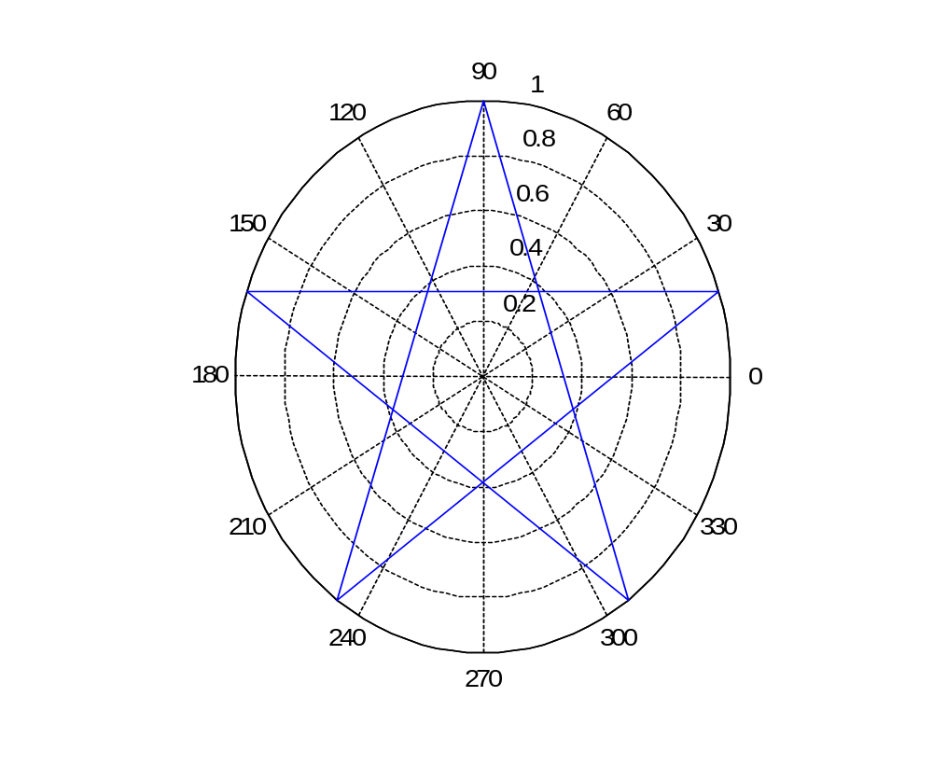
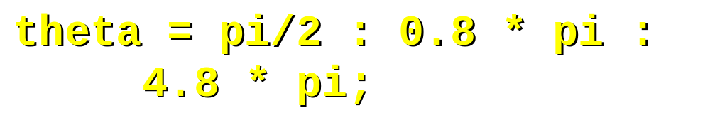


A Function with no input or output
Although the star function generates a plot, in the strictest sense it does not have any output. If you try to evaluate the expression A=star in MATLAB, you will get an error, because star has no output.

Slide 16
Notes on variables
Variables that are created inside of a user-defined function may only be accessed from inside of that function. They are referred to as local variables.
After the function completes its operations, the local variables are deleted from memory.
The only variable that appears in the workspace is the output, if any, of the function.
Conversely, functions cannot access variables from the workspace (with the exception of any input parameters they might have or “global variables”---see MATLAB help on this matter).

Slide 17
The type command
The type command followed by the name of an M-file prints the contents of the M-file onto the Command Window. This includes any user-defined or built-in functions and command scripts available in MATLAB. Using the type command instead of the editor to view the contents of M-files can prevent you from accidentally changing the contents of your files.
The type command is an alternative to using the Help Menu or editor for looking up details associated with functions & commands.

Slide 18
Exercises
Write a function that converts Celsius temperatures into Fahrenheit.
Write a function that takes force, displacement, and angle (in degrees) as input and outputs work. Use MATLAB help to find a cosine function that uses degrees.

Slide 19
Summary
Function concept and syntax
Different kinds of functions
  Functions with input and output
  Functions with input only
  Functions with output only
  Functions with no input or output

